Slide 1
Machine Learning and Neuroscience
Presented by:
Rukshar Alam, 1305031
Md.Saqib Hasan, 1305057

Slide 2
Uptill now
Neural network, Convolutional neural network
Autism
Normalization, number of nodes variation,dropout,regularization
Various forms of dropout
Theano and Tensorflow

Slide 3
Problem domain now fixed
We have two problems.
The first problem is to simulate neural networks on various datasets and then learn the shape of the resulting weight activations. Then changing the variables such as dropout, learning rate, regularization so that the shape of the curve becomes similar to normal and ASD brains.
Path based weight activation in the neural network for each class so that intersecting classes can be identified much better

Slide 4
Works of today
Study of the paper “The log-dynamic brain: how skewed distributions affect network operations”
Codes and graphs and conclusions from “cats and dogs”(small) dataset CNN { Rukshar }
Codes and graphs and conclusions from NN and MultiLayerNN on mnist(large) dataset { Saqib }
P.S. both work done in Tensorflow

Slide 6
The log-dynamic brain: how skewed distributions affect network
operations
György Buzsáki and Kenji Mizuseki

Slide 7
Introduction
Variables of functional and structural brain parameters:
synaptic weights
the firing rates of individual neurons
the synchronous discharge of neural populations
the number of synaptic contacts between neurons
the size of dendritic boutons

Slide 8
Intro ( cont’d)
These variables are assumed to have bell-shaped distribution
They are in fact strongly skewed with a heavy tail,
It suggests skewed (typically lognormal) distributions are fundamental to structural and functional brain organization.

Slide 9
Reality...
The parameters are quantified by statistics based on symmetrical, bell-shaped Gaussian (normal) probability distributions.
Such simplification is no longer tenable
The majority of interactions in highly interconnected systems, especially in biological systems, are multiplicative rather than additive.
Most anatomical and physiological features of the brain are characterized by strongly skewed distributions with heavy tails and asymmetric variations
It cannot be compressed into a single arithmetic mean like Gaussian (normal) probability distributions.

Slide 10
Skewed Distribution- Lognormal Distribution
Biological mechanisms have emergent and collective properties
Why?
many interactive processes
multiplication of a large number of variables, each is positive
This gives rise to lognormal distributions

Slide 11
The Weber–Fechner law
best-known skewed distribution in neuro science
The response to a sensory stimulus is proportional to the logarithm of the stimulus amplitude
Distance and time perception and reaction time vary logarithmically with the length of distance and time interval.
Decision making obey the Weber–Fechner law
Word usage and sentence lengths in most languages, the lengths of email messages, follow a lognormal form, irrespective of the language
Mental organization of numbers is also described by a logarithmic scale

Slide 12
Mystery...
Very little is known about the brain mechanisms that give rise to such distributions

Slide 13
Consequence
A selected minority (say “10 percent”) of neurons can effectively deal with most situations (brain states and environmental (place) changes but also context and other manipulations, such as novelty).
However, to achieve 100% accuracy it requires a very large fraction of brain networks to cooperate.

Slide 14
Network synchrony
Synchrony : simultaneous action, development, or occurrence.
Population synchrony does not vary in a Gaussian manner around a typical mean
the magnitude of synchrony, measured as the spiking fraction of all recorded neurons follows a lognormal distribution
But…. the mechanism underlying the skewed and heavy-tail distribution of population synchrony is unknown

Slide 15
Firing rates and bursts
The distribution of both stimulus-evoked and spontaneous activity in cortical neurons obeys a long-tailed, typically lognormal pattern.
Such a distribution creates a rate spectrum with a wide dynamic range.
It spans from vast numbers of very slow-firing neurons to a small fraction of fast-firing ‘champion’ cells.
the existing data clearly indicate a substantial deviation from a Gaussian rate distribution

Slide 16
Explanation
Input selectivity The neuronal population is relatively homogenous, but in different situations different subsets of neurons are activated by relevant inputs from the environment, body.
The same subset of neurons tends to be highly active under different conditions because of the strongly skewed distribution of excitability of individual neurons.
The discharge patterns of any neuron can change momentarily but the longer-term firing rates remain relatively stable.

Slide 17
Distribution of synaptic strengths
Several studies found that synaptic strengths between pairs of connected neural cells have a skewed, typically lognormal distribution
Stronger synapses are stronger on average and are reliably strong from event to event.
Skewed distribution of synaptic strengths between participating neurons may be a critical factor in sustaining lognormal firing rate distribution
A few large amplitude and stable synaptic connections seemed to dominate the entire network
Because removal of the weak synapses had little impact on population firing

Slide 18
Neural Connections
A minority of strong connections are mixed with large numbers of weak inputs, so that the connectivity profile of the area is best described by a lognormal distribution.
Lognormal rules of connectivity can combine the advantages of local computation (strongly connected cluster of neurons) and global (top-down) control, synchronization, wiring economy, information storage and communication speed
A lognormal distribution is the result of genetically defined and experience-dependent modification of synaptic strengths, biophysical properties and anatomical wiring

Slide 19
Just 10–20% of task-related neurons can predict as much as 60–80% accuracy of limb position or gripping force
Adding further information from the remaining majority of task-related neurons improves the prediction only by a modest 10–15%.

Slide 20
Neural Computation
The skewed, lognormal-like distributions point to a hard-wired backbone in neural-network activity, due to the reliable correlations between various physiological log scale parameters across situations. Importantly, despite a
Majority of neurons, having plastic properties, can provide sufficient flexibility for dynamic neural coding.
Synapses and neurons at the left and right tails of the distributions may seem to serve different functions, but there is no clear boundary between their postulated functions.
BUT accurate and reliable performance requires the involvement and cooperation of a very large brain circuit

Slide 21
Neural Computation(cont’d)
Log scaling can compress a large input range into a smaller, more manageable output range, and after logarithm transformation, multiplication and division become simpler addition and subtraction problems

Slide 22
Normal and Lognormal distribution
Normal (Gaussian) distribution is a continuous probability distribution and is non-zero over the entire real line.
It is characterized by a bell-shaped curve that is symmetrical around the mean
it can be quantified by two parameters — the mean and the SD.
Lognormal distribution is a probability distribution of a random variable whose logarithm is normally distributed
If X is lognormally distributed if log(X) has a normal distribution.

Slide 23
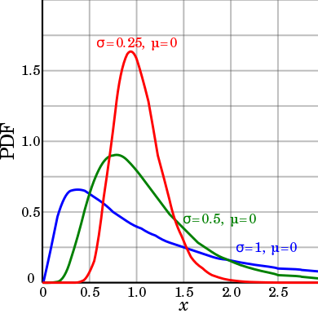
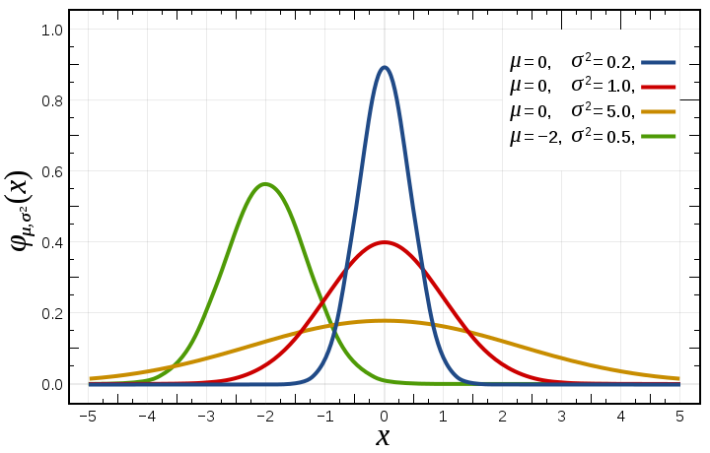

Slide 24
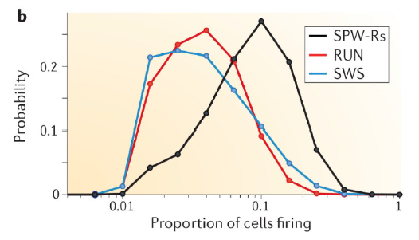
Skewed distribution of the magnitude of population synchrony.
The x axis shows the proportion of cellfiring during sharp-wave
ripples (SPW-Rs) or behavioural tasks
(RUN) or slow-wave sleep (SWS),

Slide 25
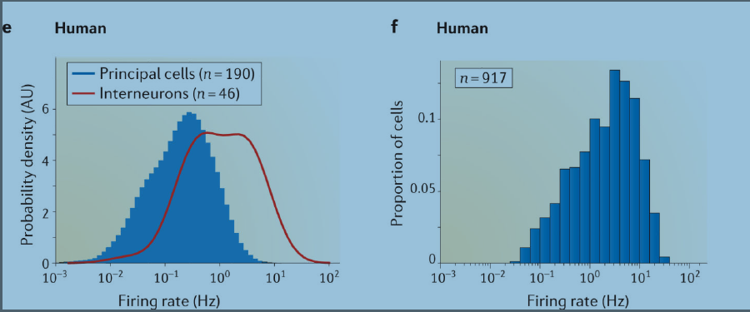
Lognormal distribution of firing rates in the cortex
Firing-rate distribution of neurons in the human middle temporal during sleep. Principal cells and putative interneurons are plotted separately.
f Firing-rate distribution of neurons in multiple cortical areas of human patients

Slide 26
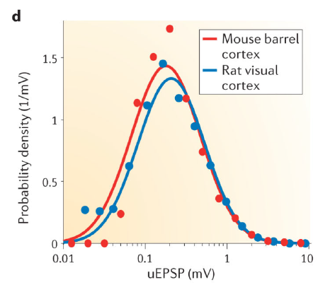
Lognormal distribution of synaptic weights and spike transfer probability

Slide 27
User made dataset training to categorize images containing cats and dogs using convolutional neural network
3 convolution layers
2 fully connected layers
Trained with 500 images of cats and 500 images of dogs.

Slide 28
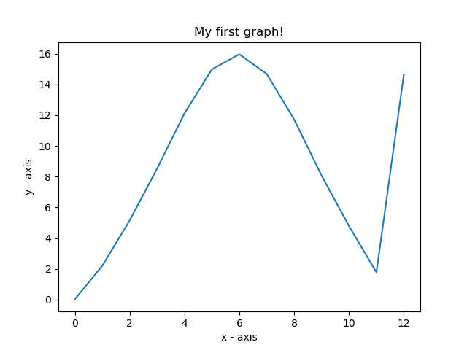
Iteration Change
nodes of fc : 128
conv1 = 32 conv2 = 32 conv3 = 64
learning rate = 1e-4
adam optimizer
.4 drop out
iteration 600
max pool 2X2 conv filter 3X3
accuracy ~82%

Slide 29
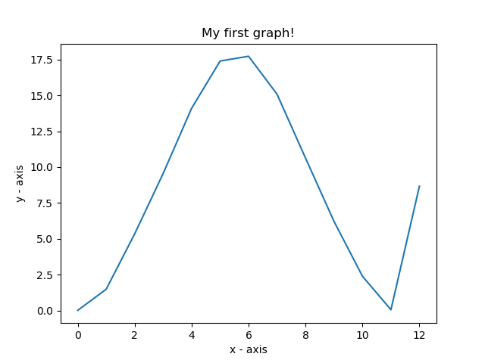
nodes of fc : 128
conv1 = 32 conv2 = 32 conv3 = 64
learning rate = 1e-4
adam optimizer
.4 drop out
iteration 1000
epoch 40
max pool 2X2 conv filter 3X3
accuracy ~90%

Slide 30
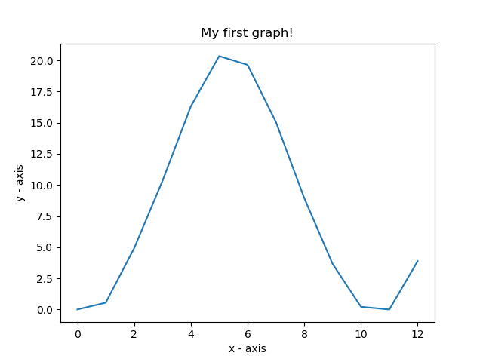
nodes of fc : 128
conv1 = 32 conv2 = 32 conv3 = 64
learning rate = 1e-4
adam optimizer
.4 drop out
iteration 2000
epoch 80
max pool 2X2 conv filter 3X3
accuracy ~96%

Slide 31
Observation
As the number of iterations grow, accuracy increases and the distortion at the right hand side(proportion of highest weights) of the graphs also decreases meaning overfitting is less probable.

Slide 32
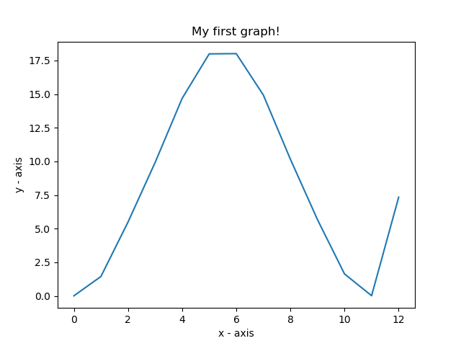
Drop Changes:
nodes of fc : 128
conv1 = 32 conv2 = 32 conv3 = 64
learning rate = 1e-4
adam optimizer
.6 drop out
iteration 1000
epoch 40
max pool 2X2 conv filter 3X3
accuracy ~96%

Slide 33
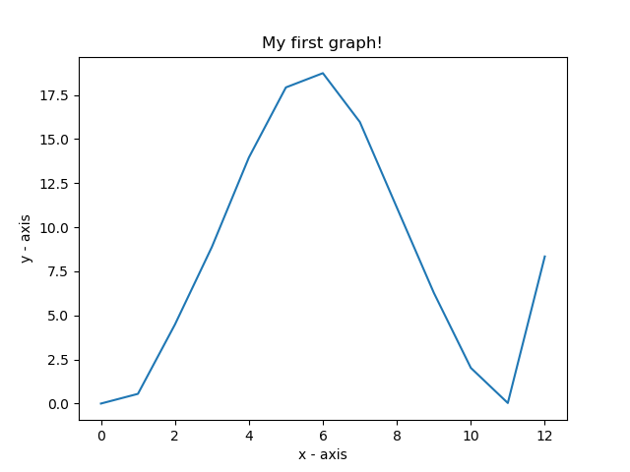
nodes of fc : 128
conv1 = 32 conv2 = 32 conv3 = 64
learning rate = 1e-4
adam optimizer
.8 drop out
iteration 1000
epoch 40
max pool 2X2 conv filter 3X3
accuracy ~96%

Slide 34
Observation
Drop out’s ideal value is .4-.6 for the distortion at the right hand side(proportion of highest weights) of the graphs also decreases in this case.
Outside this area overfitting probability increases with the increase in distortion

Slide 35
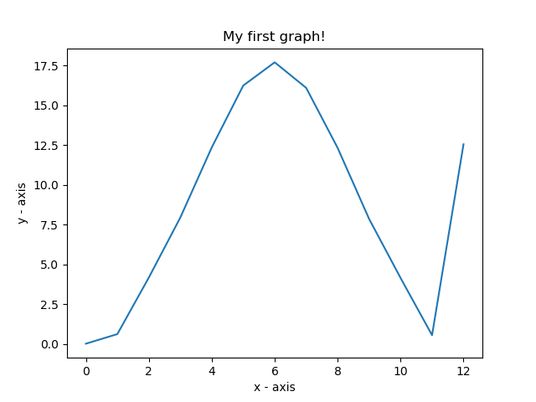
Filter Change
nodes of fc : 128
conv1 = 16 conv2 = 16 conv3 = 32
learning rate = 1e-4
adam optimizer
.5 drop out
iteration 1000
epoch 40
max pool 2X2 conv filter 3X3
accuracy ~96%

Slide 36
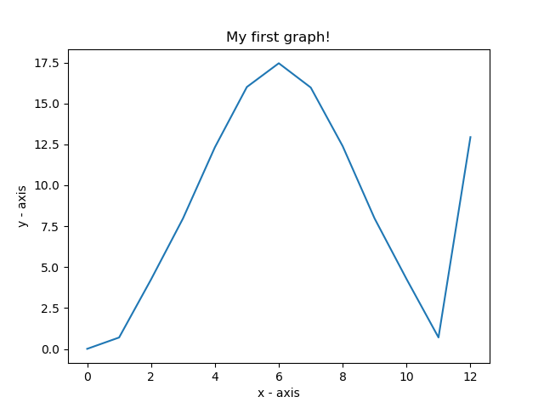
nodes of fc : 128
conv1 = 40 conv2 = 40 conv3 = 72
learning rate = 1e-4
adam optimizer
.5 drop out
iteration 1000
epoch 40
max pool 2X2 conv filter 3X3
accuracy ~96%

Slide 37
Observation
Changing filters doesn’t affect the accuracy or weight distribution much unless other parameters are manipulated

Slide 38
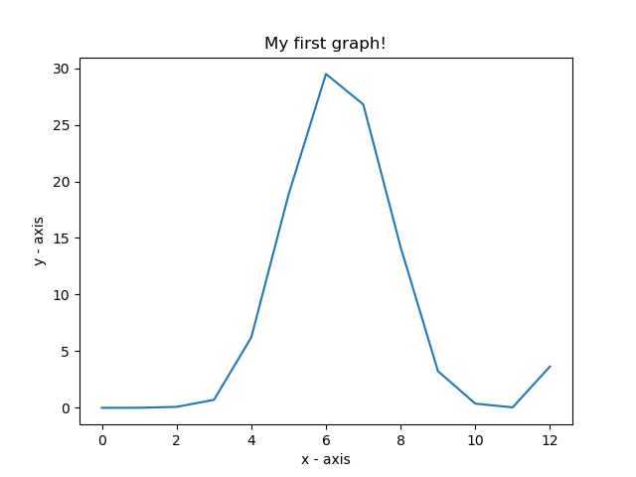
nodes of fc : 128
conv1 = 32 conv2 = 32 conv3 = 64
learning rate = 1e-3(changed)
adam optimizer
.4 drop out
iteration 600
max pool 2X2 conv filter 3X3
accuracy ~82%
Approximates lognormal distribution

Slide 39

nodes of fc : 256
conv1 = 32 conv2 = 32 conv3 = 64
learning rate = 1e-4
adam optimizer
.5 drop out
iteration 2000
epoch 80
max pool 2X2 conv filter 3X3
accuracy ~97%

Slide 40

nodes of fc : 384
conv1 = 32 conv2 = 32 conv3 = 64
learning rate = 1e-4
adam optimizer
.5 drop out
iteration 2000
epoch 80
max pool 2X2 conv filter 3X3
accuracy ~97%

Slide 41
Observation
Changing node numbers increases the complexity of the network. But without improving the dataset the added complexity will contribute to the overfitting.

Slide 42
MNIST Single Layer NN Observations
Simple Neural Network with one hidden layer
Weight variations observed and plotted
The variables changed: number of nodes in hidden layer and learning rate
Graph of weight values/weight activations vs number of edges/proportion plotted

Slide 43
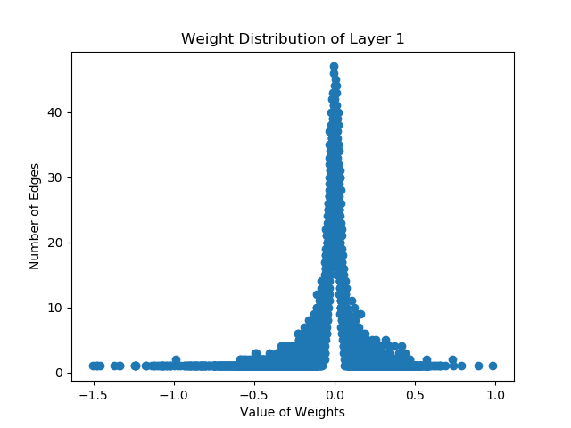
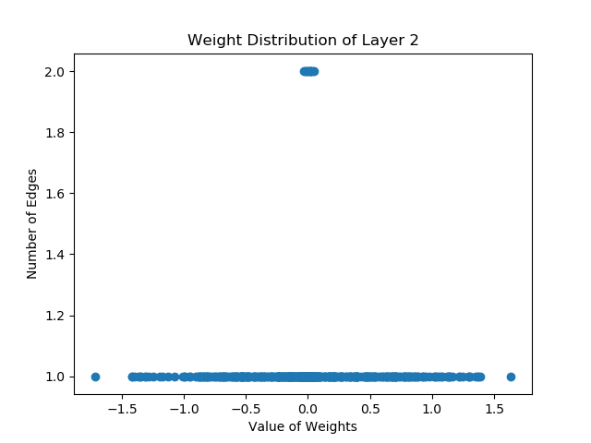
50 Nodes, Accuracy 96.70%

Slide 44
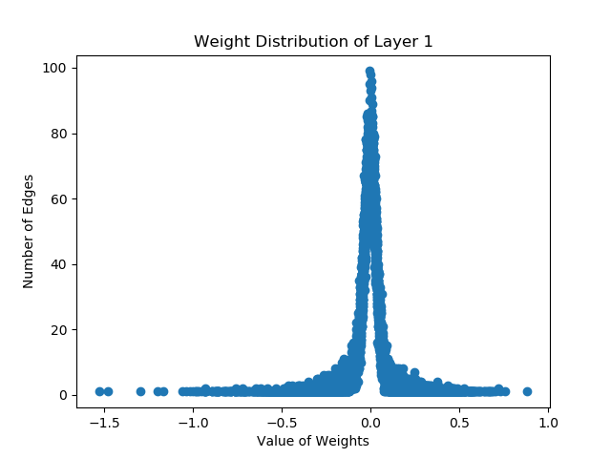
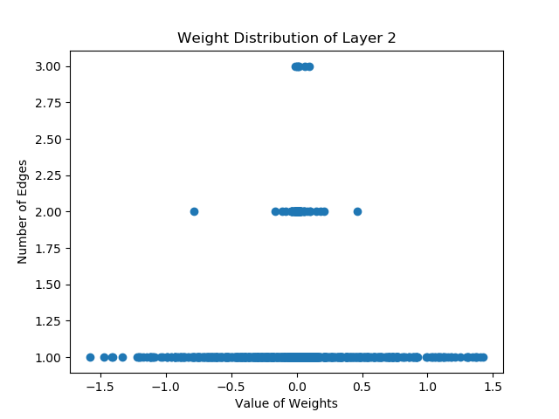
100 Nodes, Accuracy 96.34%

Slide 45
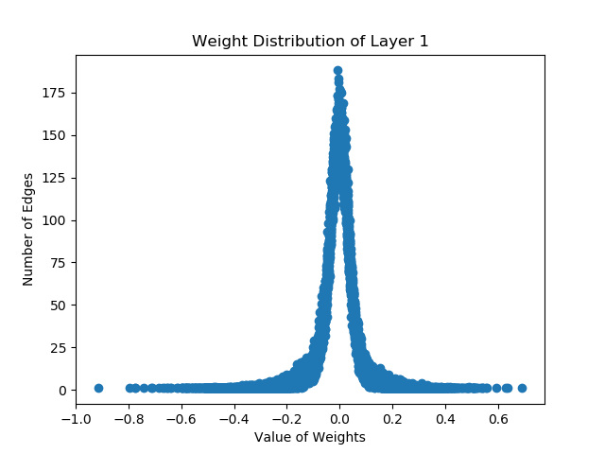
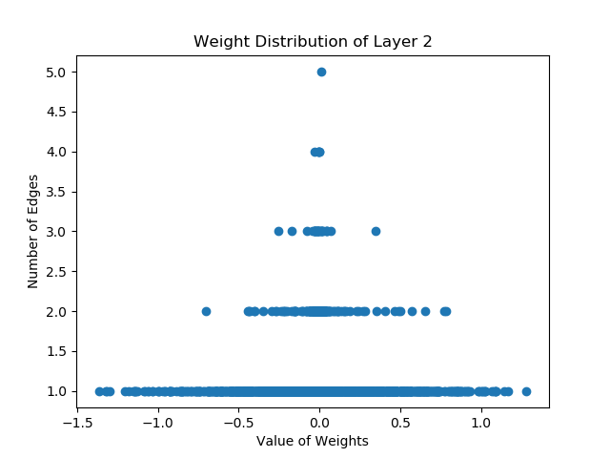
200 Nodes, Accuracy 97.78%

Slide 46
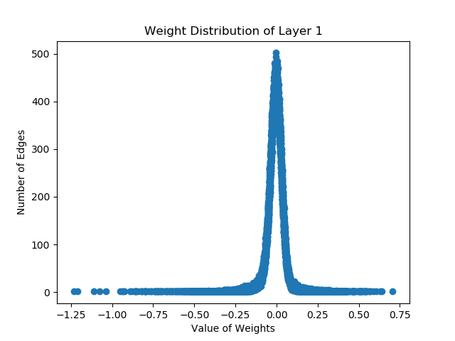
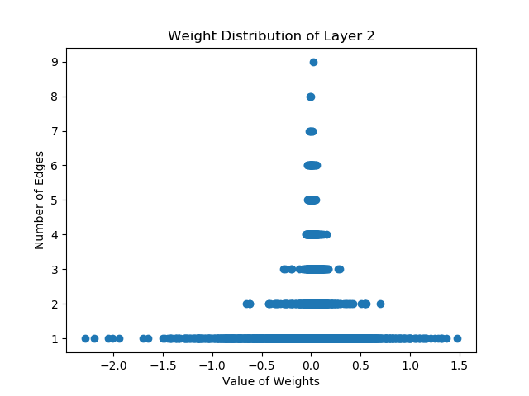
500 Nodes, Accuracy 97.74%

Slide 47
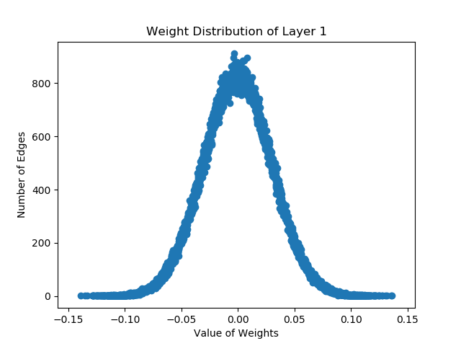
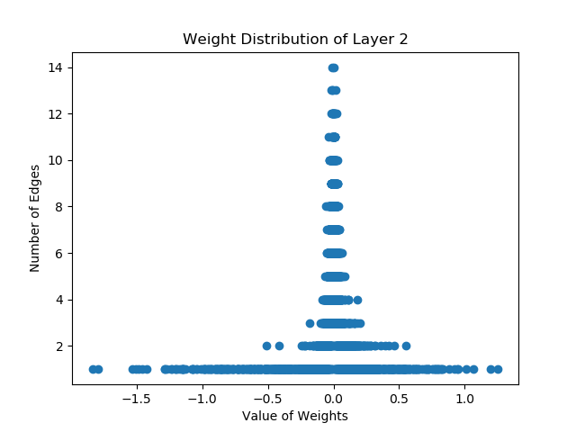
800 Nodes, Accuracy 10.28%

Slide 48
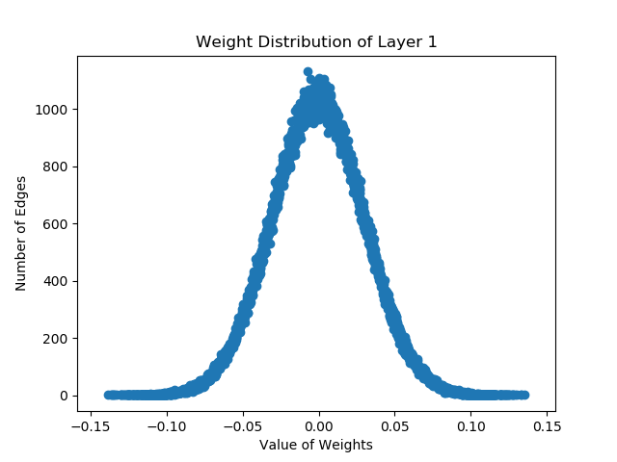
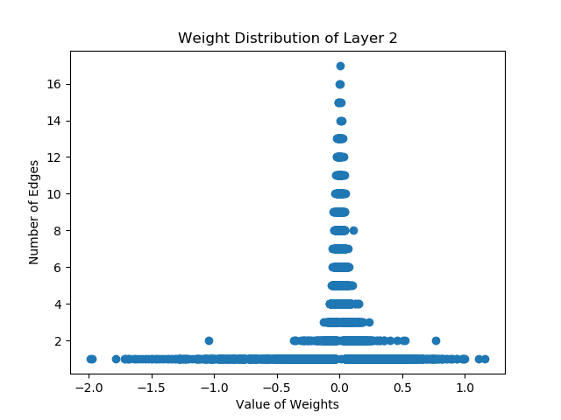
1000 Nodes, Accuracy 9.8%

Slide 49
50 Nodes, Accuracy 96.70%

Slide 50
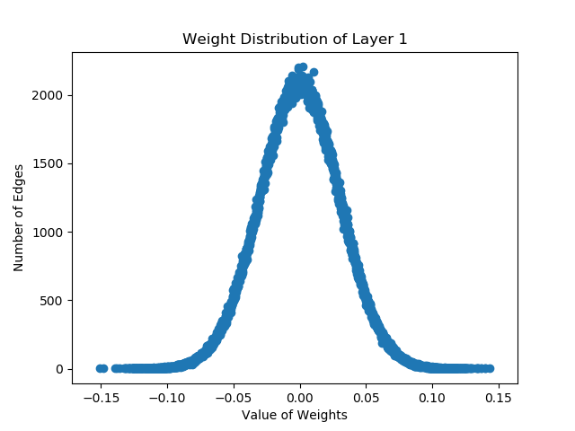
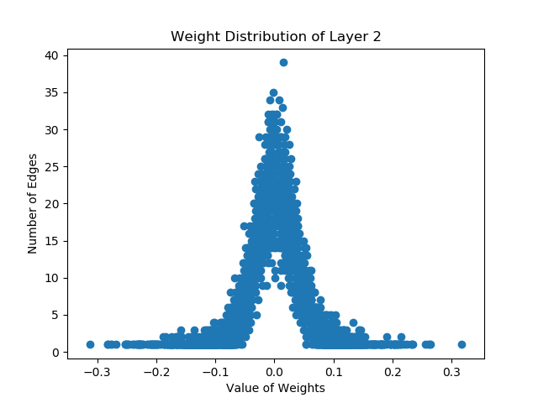
2000 Nodes, Accuracy 10.32%

Slide 51
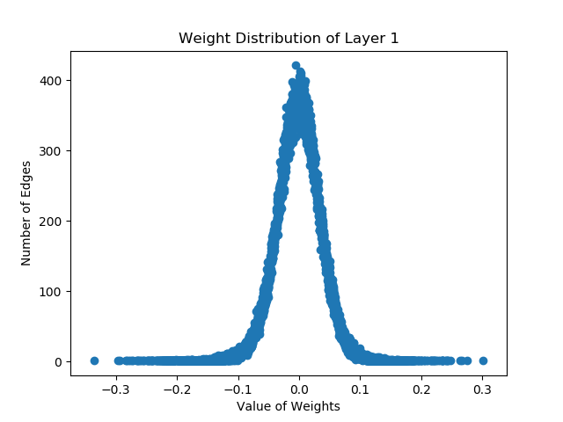
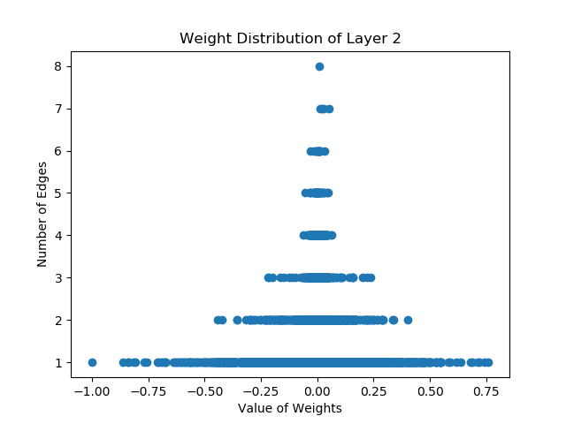
Learning Rate 0.1 97.61%

Slide 52
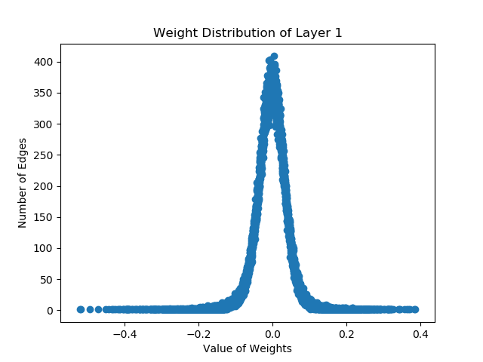
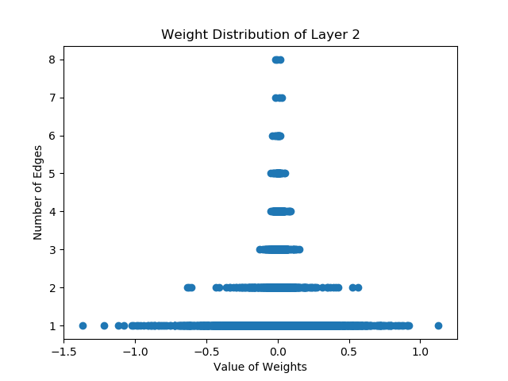
Learning Rate 0.2 97.85%

Slide 53
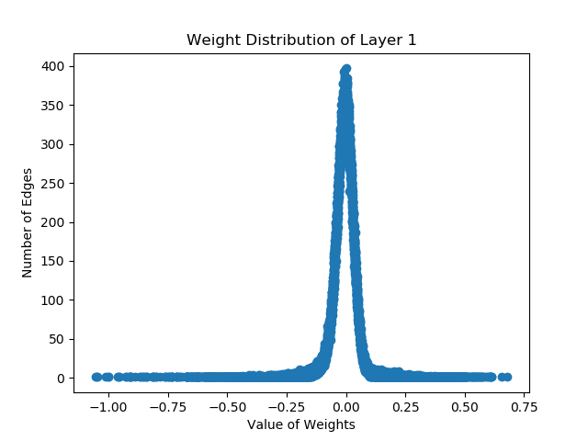
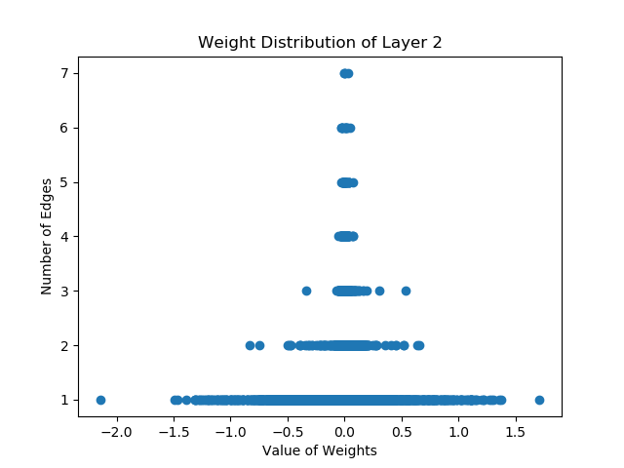
Learning Rate 0.5, Accuracy 97.73%

Slide 54
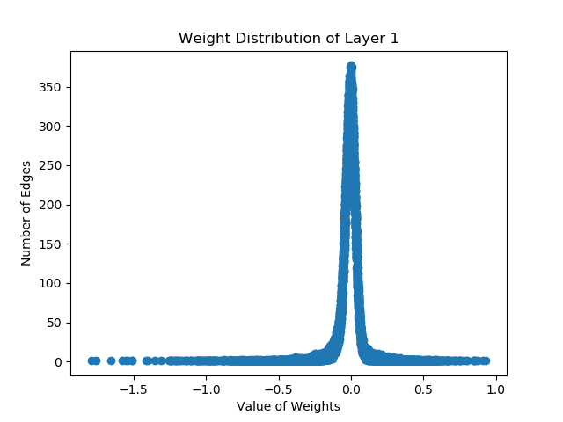
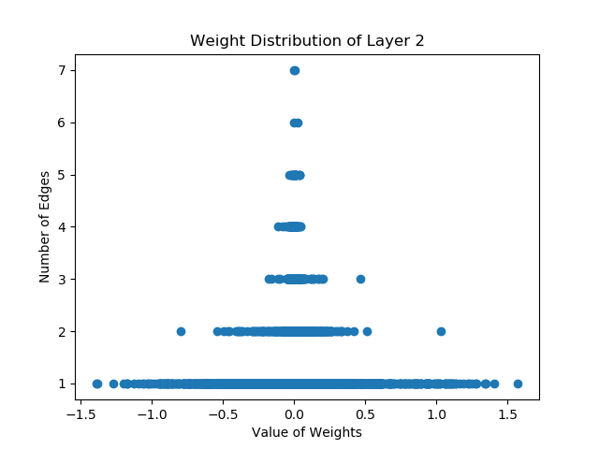
Learning Rate 0.8, Accuracy 96.67%

Slide 55
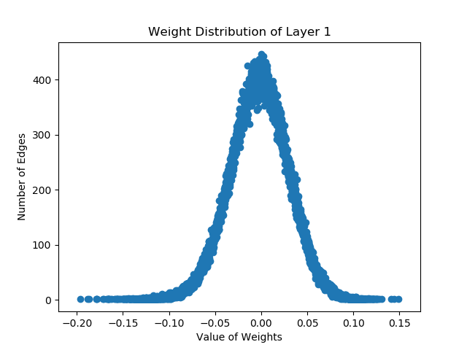
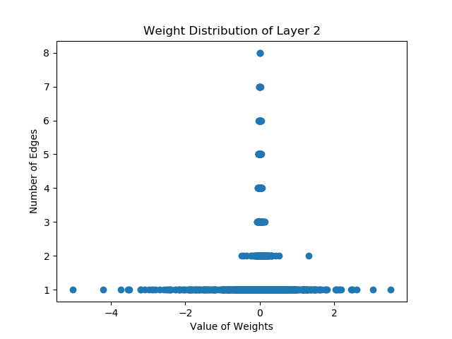
Learning Rate 1.5, Accuracy 10.1%

Slide 56
Some personal conclusions from data
Large number of nodes causes underfitting, results in very inaccurate neural networks
As number of nodes increase, the distribution of weights layer 1 become less skewed or spiked and more distributed or normal
Inaccurate neural networks show more normal distribution of weights
Accurate neural networks seem to have a high number of nodes having same weight and very few number of nodes in the other weights

Slide 57
MNIST Multi Layer NN Observations
Deep learning NN with three hidden layers
Changes applied to number of nodes and dropout
Characteristic graphs like previously plotted

Slide 58
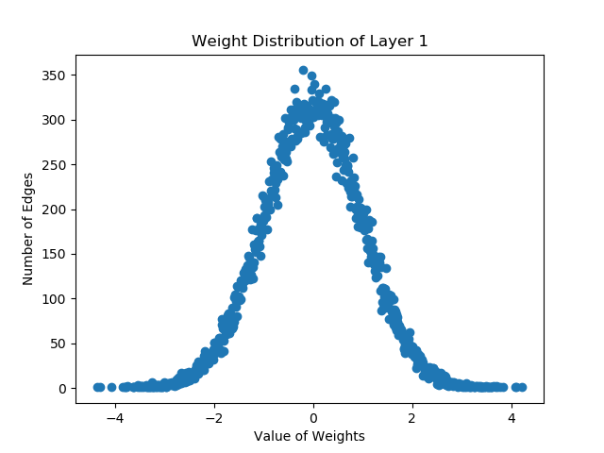
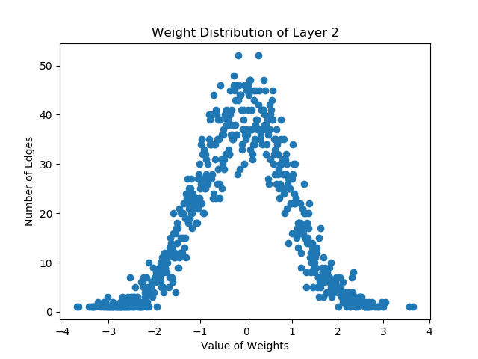
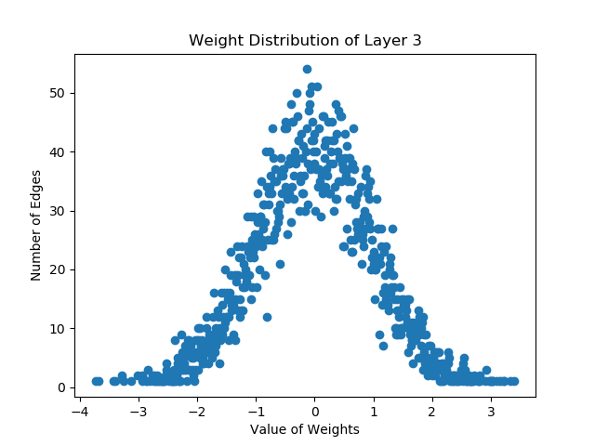
Number of nodes 100

Slide 59
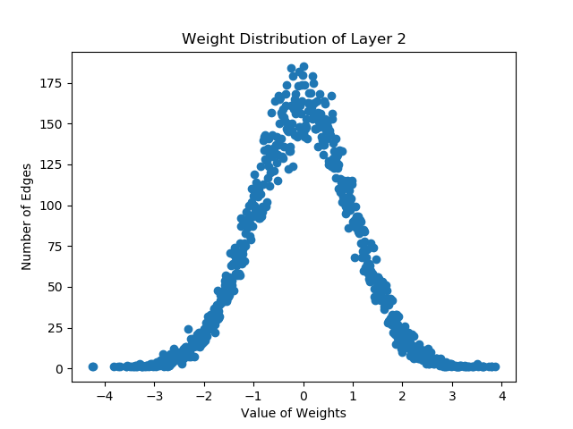
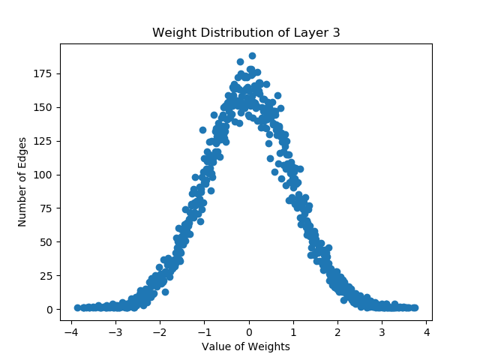
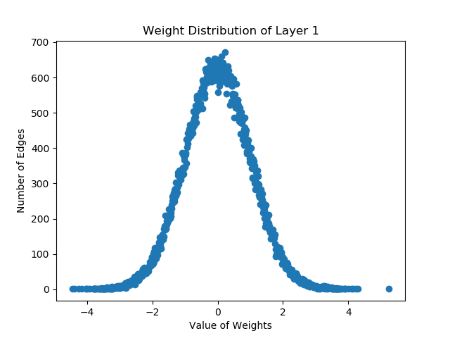
Number of nodes 200

Slide 60
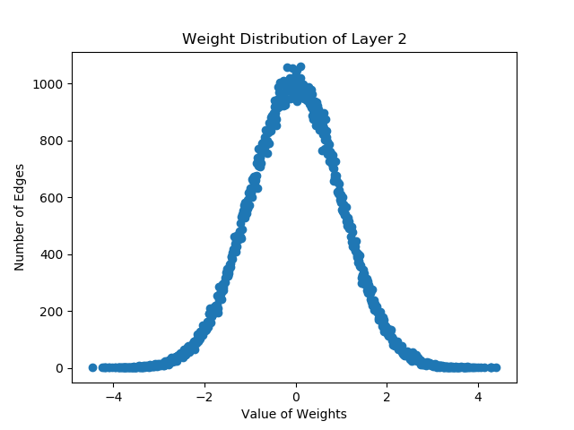
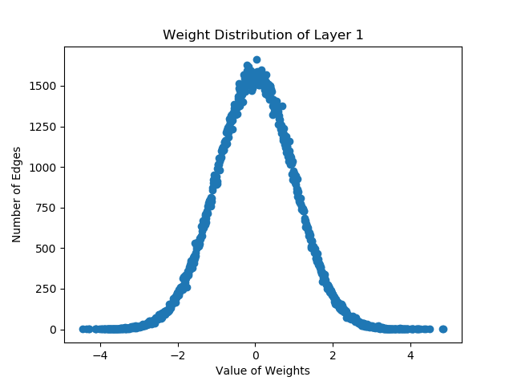
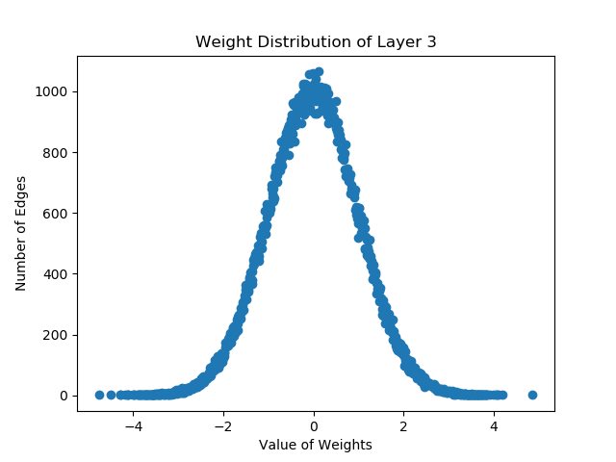
Number of nodes 500

Slide 61
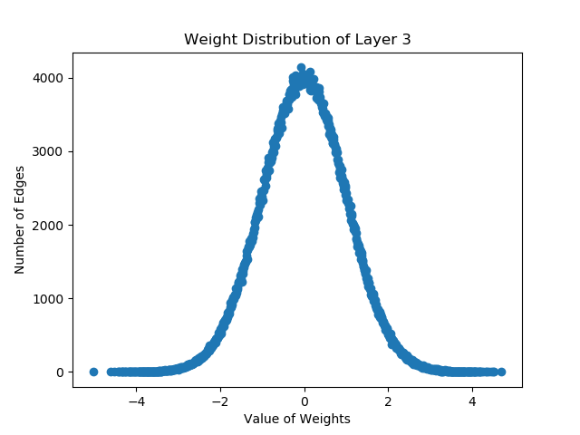
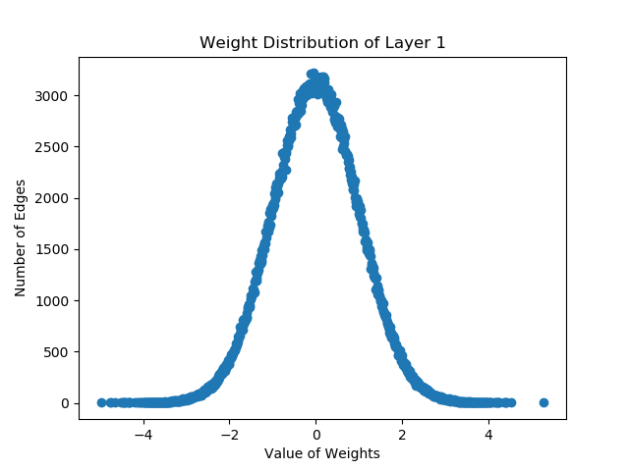

Number of nodes 1000

Slide 62

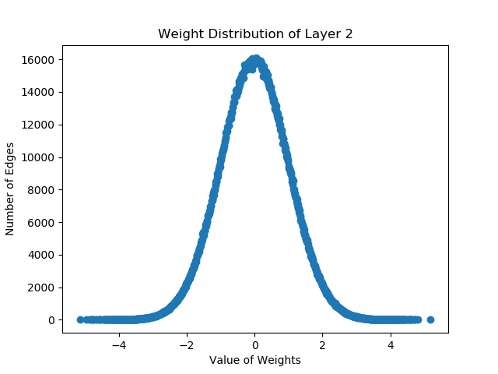
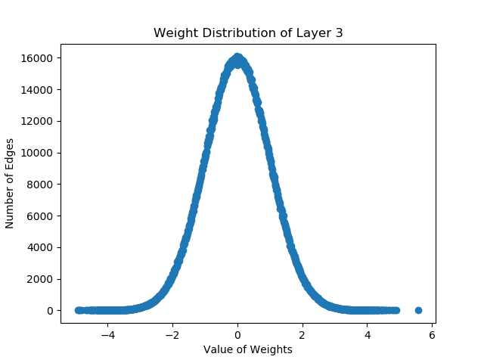
Number of nodes 2000

Slide 63



Dropout rate 1.0, Accuracy 94.57%

Slide 64



Dropout rate 0.8, Accuracy 95.62%

Slide 65



Dropout rate 0.5, Accuracy 85.45%

Slide 66



Dropout rate 0.2, Accuracy 85.45%

Slide 67
Conclusions from simulation
Inaccuracy leads to more scatter of values
Standard deviation does not vary much
Normal distribution in all graphs
No spikes
The layers compensate each others drawbacks so the distribution is same even as dropout and number of node changes

Slide 68
Next work that is in mind
The codes on dropout and its variations must be obtained
The graphs of the firing rate of people with autism
CNN code on MNIST and bringing change in the variables
Studying paper on distribution of weights in neural networks to understand why we are getting the results that we are getting

